Slide 1
Maze Generation and Solving
Sam Baumann
Apr 5, 2023

Slide 2
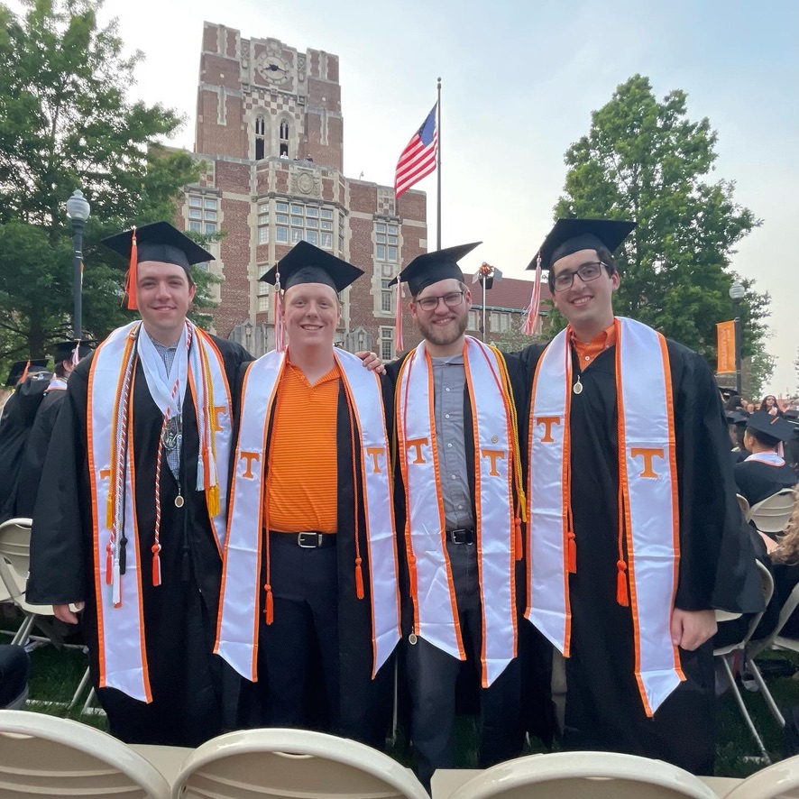
About me
MS Candidate in Computer Science
BS in Computer Science Spring ‘22
Advisor: Dr. Plank
Employment: American Accessories Int’l
Notes:
First and last year master’s student (5 year program)
Graduated from UT Last Spring
Dr. Plank is my advisor – don’t do research work
Do software engineering for American Accessories Int’l

Slide 3
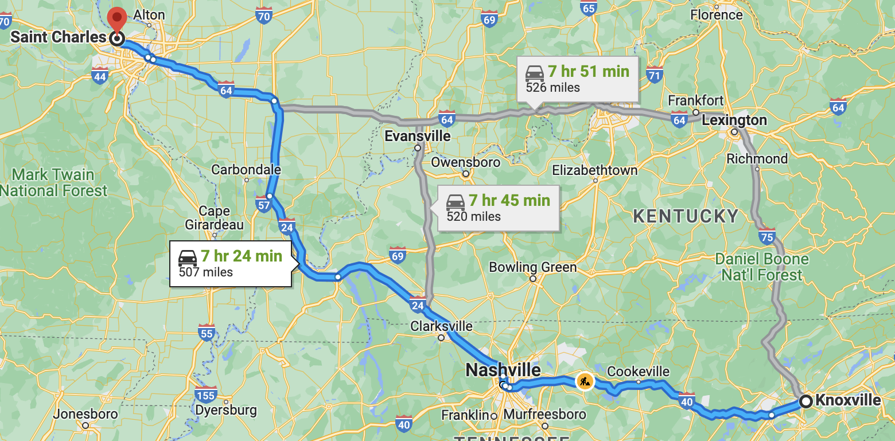
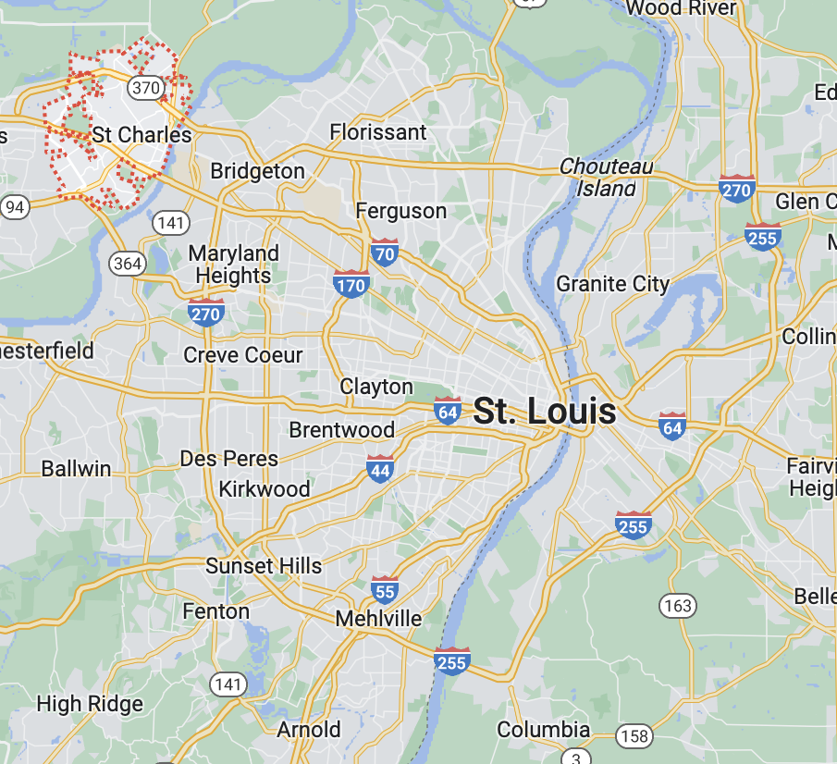
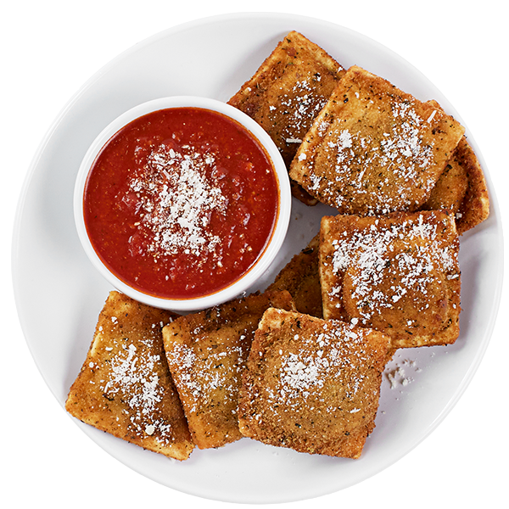
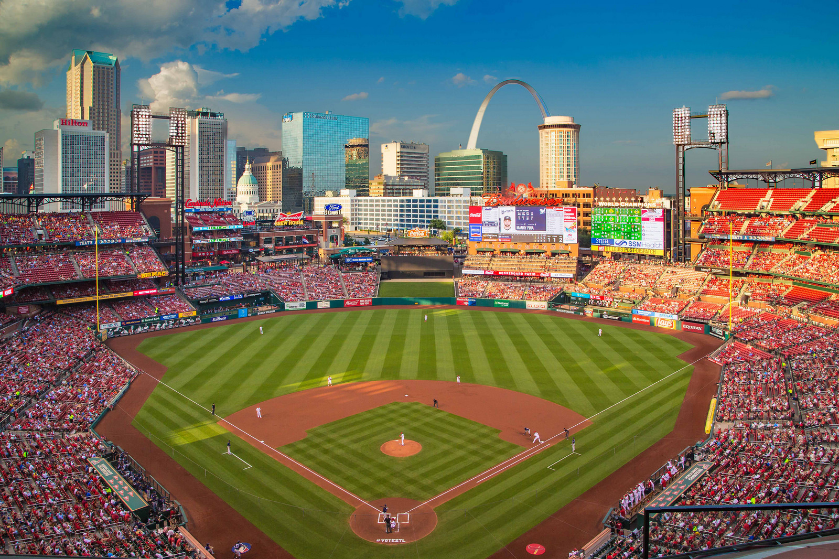
About Me
Hometown: St. Charles, MO

Slide 4
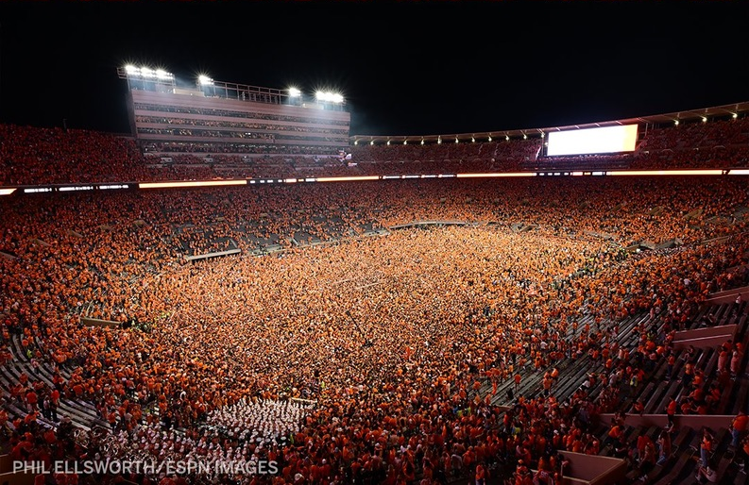


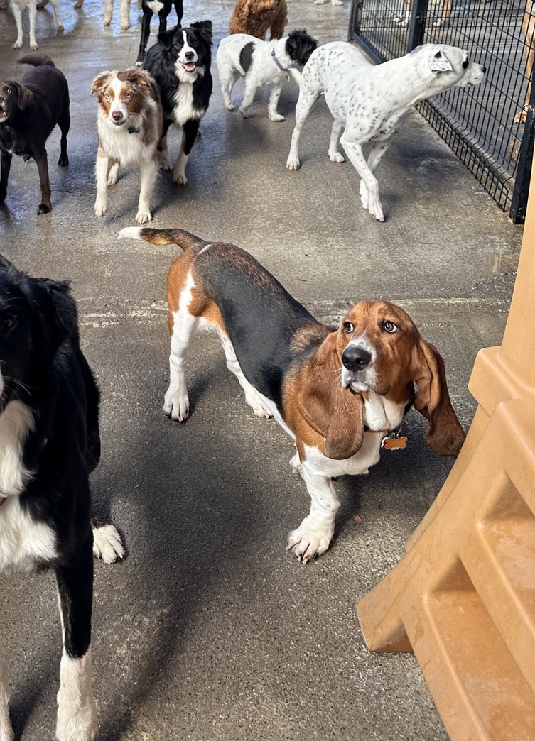
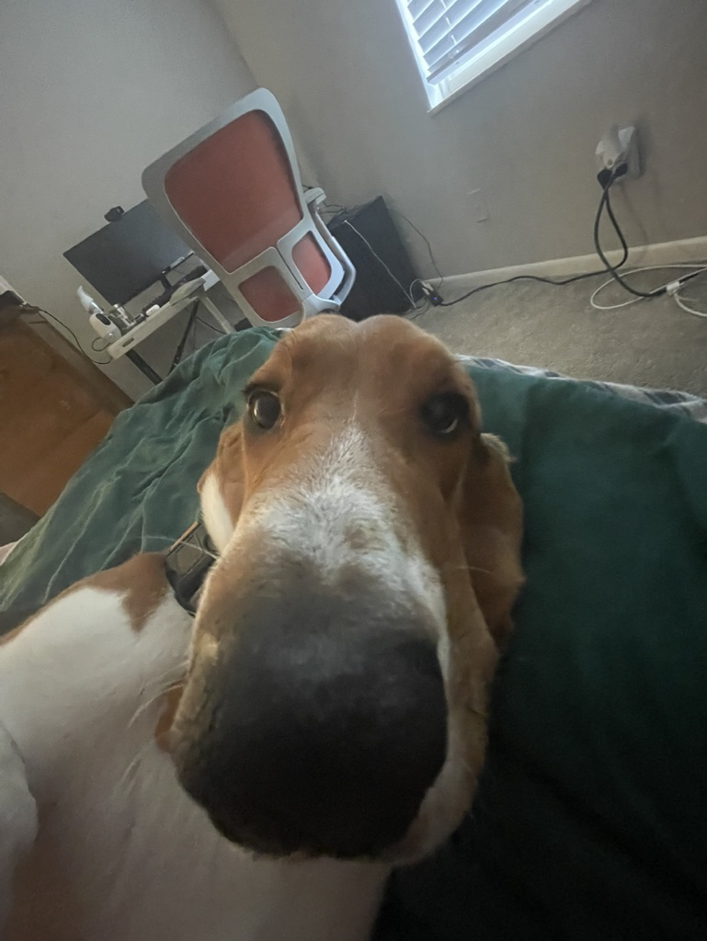
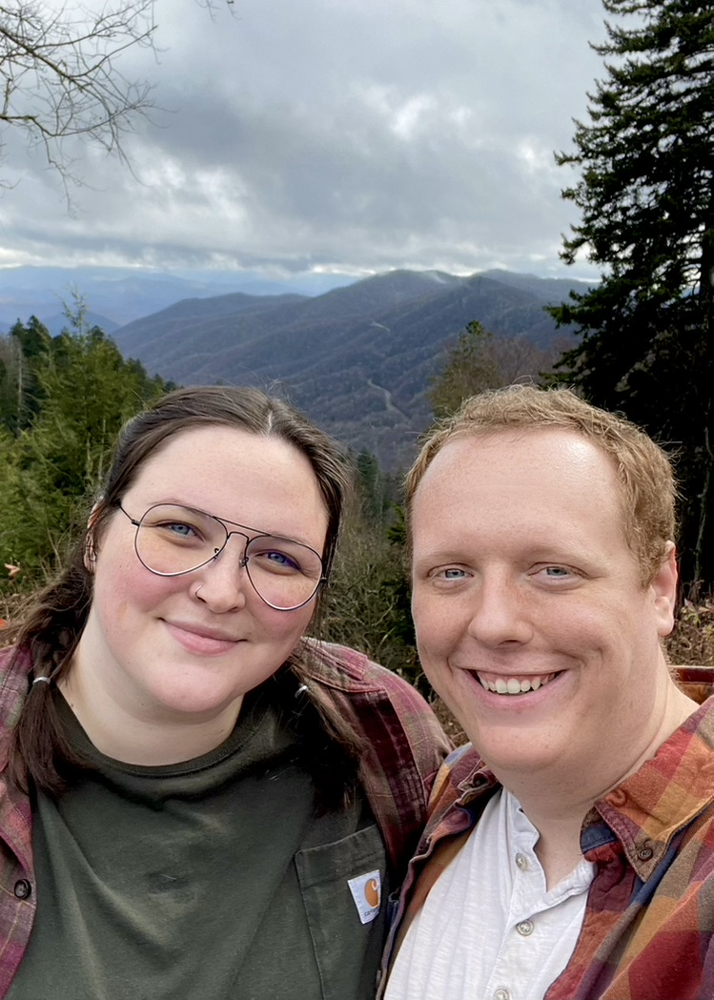
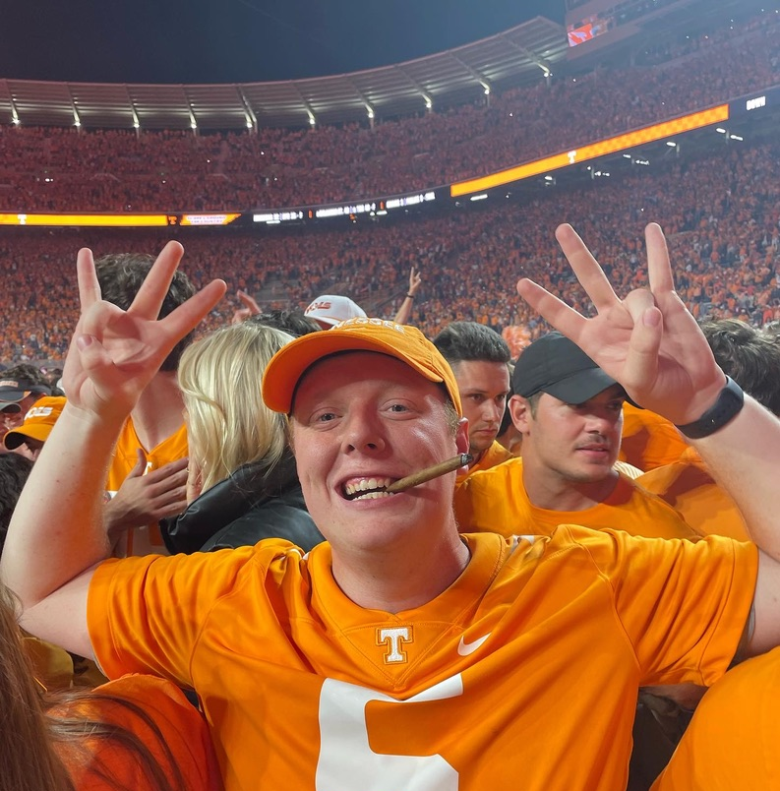
About Me

Slide 5
Test Questions
(Open-ended) What qualities are desirable in an ideal maze?
??
What is a non-graph theory based solving approach that is highly parallelizable?

Slide 6
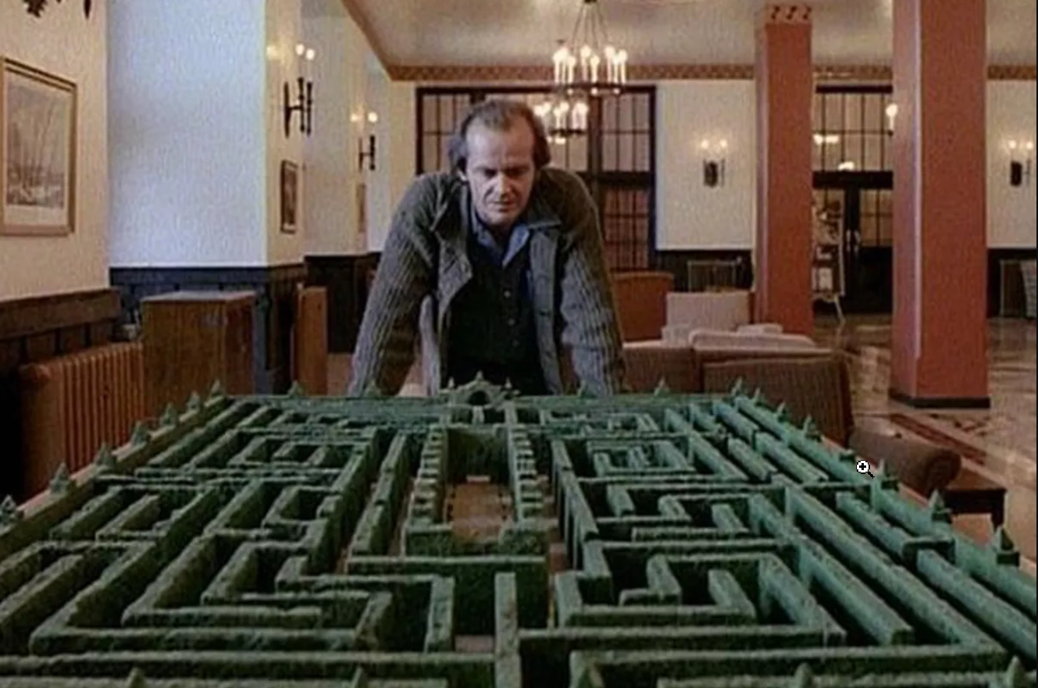
Agenda
History
Maze Generation Algorithms
Maze Solving Algorithms
Applications
Implementation, visualization, and comparison.
Open issues
References
Discussion

Slide 8
References
https://en.wikipedia.org/wiki/Maze_generation_algorithm
https://www.smithsonianmag.com/travel/winding-history-maze-180951998/

